Slide 1
Ghidra-LLM: Large Language Models for Static Reverse Engineering
Spring Week 11 Update
Project 11: Bisesh, Mack, Maximilan, Craig, Justin

Slide 2
Review - Project Goal
In this project, our team will create large language model support for NSA’s new reverse engineering tool, Ghidra.
Reverse engineering is inherently a lossy process. Valuable context and data is often lost or obscured. Our goal is to use machine learning to bridge this gap.

Slide 3
Review – Project Process
Multi-step project that consists of numerous phases
Phase 1: Research & Red Teaming current LLM application (Fall 2024)
Phase 2: Improving current models (Late Fall 2024 – Early Spring 2025)
Phase 3: Further refinement & integrating our new model into Ghidra and Documentation (Spring 2025)

Slide 4
Review – Phase 1 Research & Red Teaming current LLM application (Fall 2024)
We are taking advantage of a current existing open-source large language model "LLM4Decompile".
This LLM already has the ability to decompile binary/assembly to C (Best version ~65% accurate)
Our current goal is to refine this LLM to become more accurate.
How do we accomplish this?

Slide 5
Review – Phase 2 Improving current models (Late Fall 2024 – Early Spring 2025)
Build the RAG Pipeline
Build the DataBase for the Pipeline
Expand on the Red Teaming efforts and put all Hallucinations into buckets
Finetune everything

Slide 6
Review – Phase 3 Further refinement & integrating our new model into Ghidra and Documentation (Spring 2025)
Documentation, Documentation, Documentation
RAG Pipeline Refinement

Slide 7
Team Objectives
Our team has the latest LLM4Decompile model running on our development environment
Hosting this model on ubuntu desktop provided by GMU, with code repository (github) https://github.com/SPIRE-GMU/SPIRE_GLLeN/tree/dev
With the model running, we can begin to test, improve, and refine it.
We have split into 2 teams to achieve these objectives
RAG Team – This team oversees building a RAG Pipeline that we will combine with LLM4Decompile to improve accuracy
Red Team – This team oversees evaluating the current LLM4Decompile model and determining where it falls short.

Slide 8
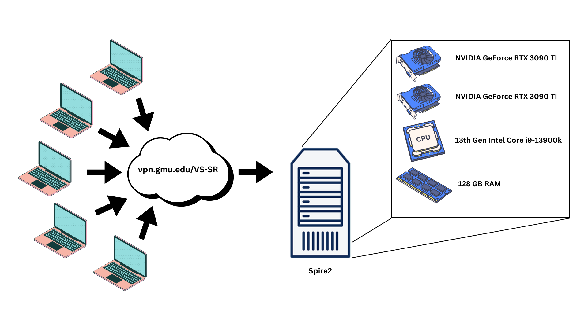
Lab Environment

Slide 9
Red Team (Mack, Max, Bisesh) Objectives – Last 2 weeks
Analyzed preliminary results of rag testing
Tested "success" comparison code (did not work)
Worked to fix errors in the comparison code for final results

Slide 10
Red Team (Mack, Max, Bisesh) Objectives – Next 3 weeks
Collect data on final results en masse
Do the poster/brochure/paper
Compile all results and data associated for presentation.

Slide 11
RAG Team (Craig, Justin) Objectives – Last 2 Weeks
Rebuilt and expanded sample database to include the ~25k training dataset ExeBench files
Changed process to convert executable object files directly to CFG's instead of using an LLM. Reduces manually introduced error
Finished pipeline control scripts, and began running large scale tests to create metrics.

Slide 12
RAG Team (Craig, Justin) Objectives – Next 2 Weeks
Continue bulk testing efforts
Refine search / comparison methods to reduce time requirements
Make final adjustments and clean up code
Submissions for presentation, paper, poster, brochure, and final delivery.

Slide 13
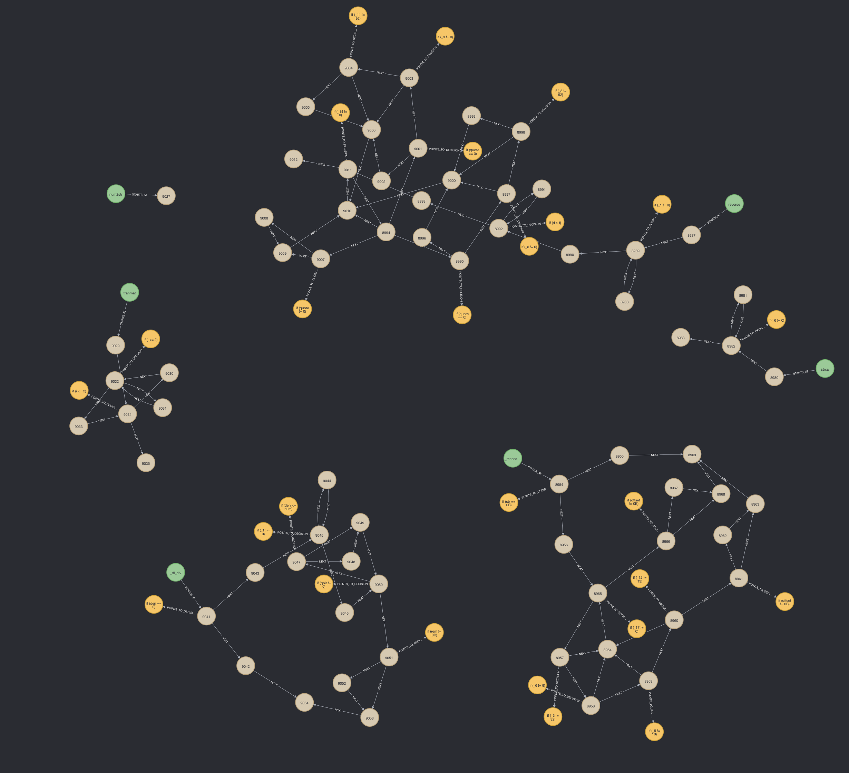
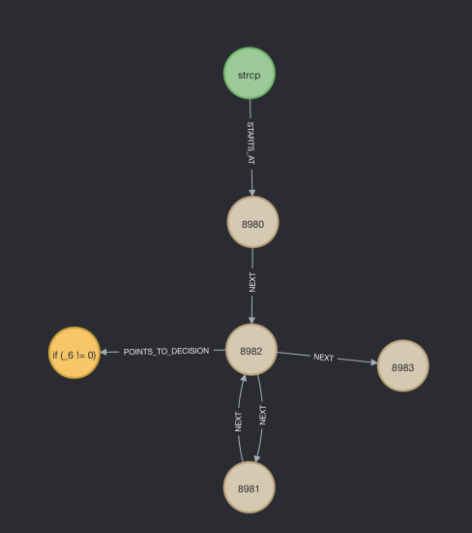
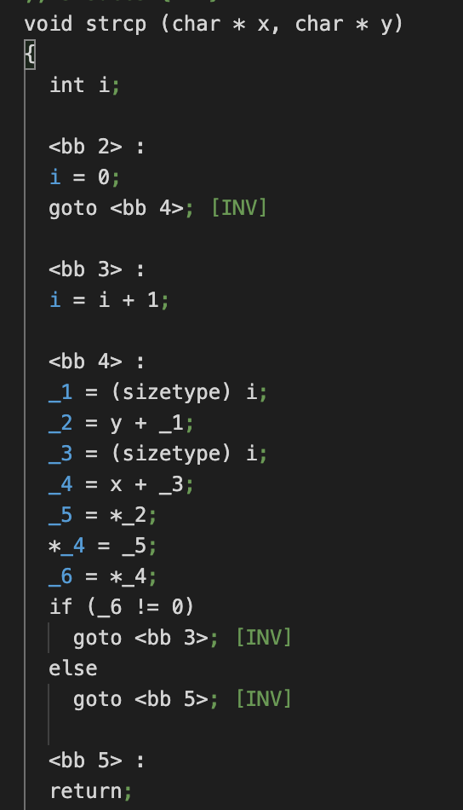
CFG Map

Slide 14
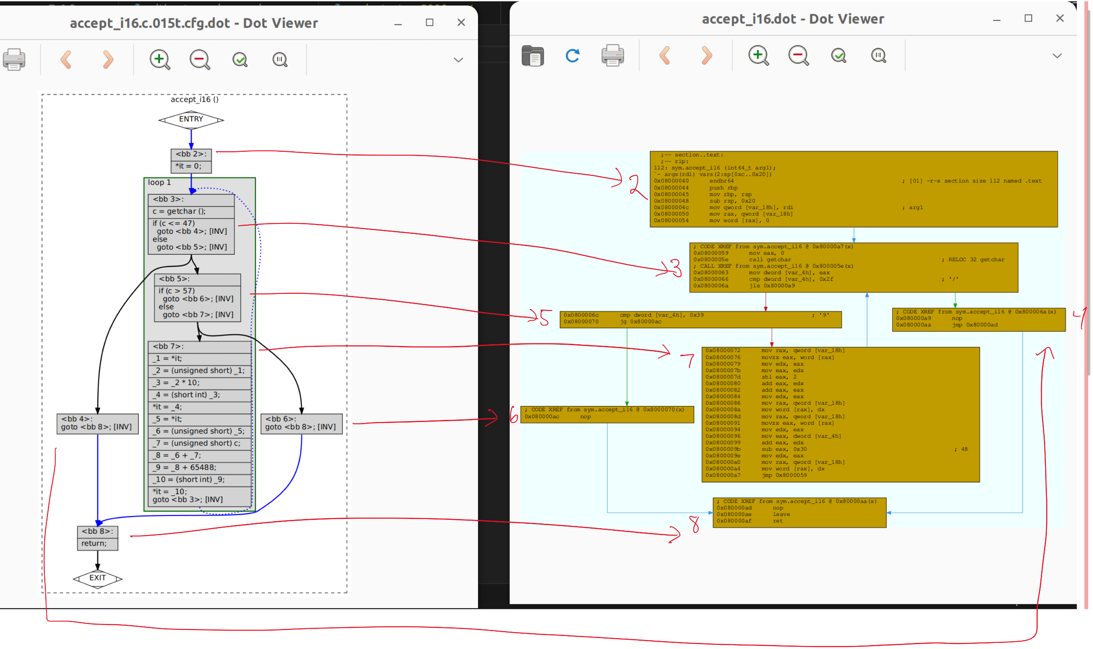

Slide 15
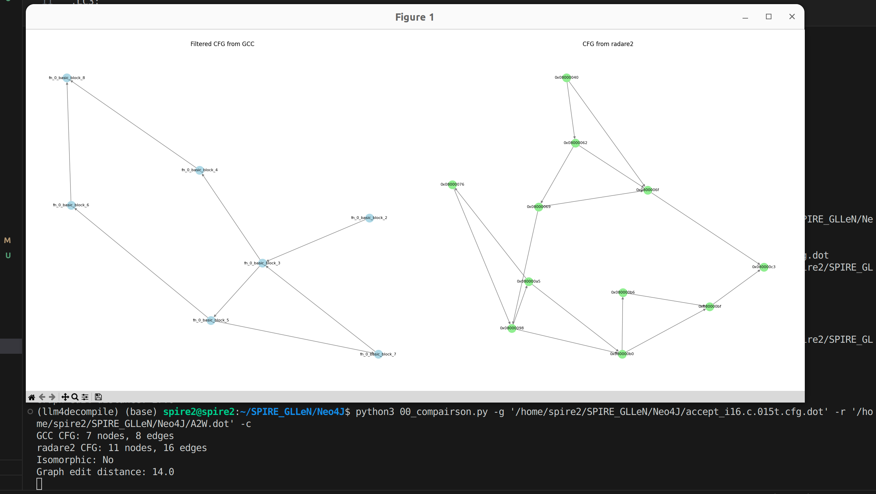

Slide 16
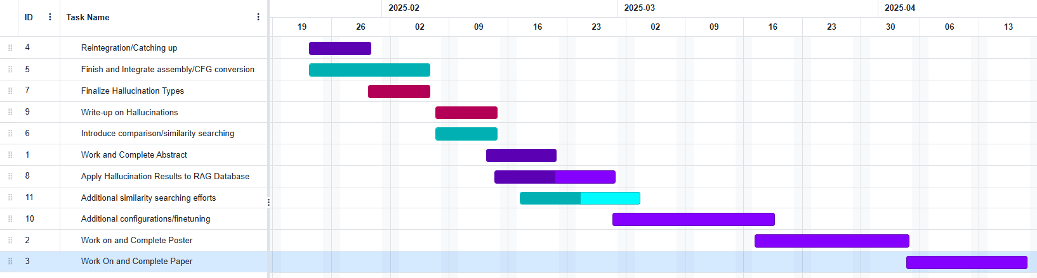
Gantt Chart – Phase 2

